Slide 1


Group name: Team 2

Slide 2
General, relevant market information
Economic Backdrop: U.S. inflation is hovering around ~3% (annual CPI) – still above the Fed’s 2% goal but easing from 2024 levels. Unemployment remains low ~4.1%, reflecting a resilient labor market. The Federal Reserve has paused its interest rate hikes, holding the fed funds rate ~4.5% after a series of late-2024 cuts, with markets expecting potential rate reductions later in 2025 if inflation trends downward.
Market Sentiment: 2024 was a banner year for equities, with financial stocks up over 30% (outpacing the S&P 500 by ~5%) on post-election optimism. Coming into 2025, sentiment is more cautious – an initial rally on hopes of Fed easing quickly fizzled as investors refocused on persistent headwinds​ tradingview.com . Notably, high-flying tech names saw a Q1 2025 pullback (the “Magnificent Seven” had their worst relative quarter since 2022)​tradingview.com , prompting a rotation into value sectors like financials.
Sector Performance: The financial sector has been buoyant. Banks benefited from rising net interest income in 2024 and a rebound in deal-making activity. Major bank stocks (e.g. JPM, GS, WFC) soared in 2024 amid Fed rate cuts, booming M&A, and robust economic growth​finance.yahoo.com. Large diversified banks and payment processors are expected to remain leaders into 2025 as fundamentals stay solid. However, late-2024 policy uncertainty injected volatility, and bank shares saw some profit-taking early 2025 on macro jitters.
Trade Policy & Tariffs: The resurgence of Trump-era trade policies is a double-edged sword. Markets have shifted focus back to tariffs – President Trump’s plans for new or higher import tariffs (and potential reciprocal duties) are raising concerns about corporate costs​ tradingview.com. Analysts warn these trade barriers could stoke inflation and dampen consumer spending, slowing the economy ​tradingview.com. For the banking sector, a trade-driven uptick in inflation could lead to higher interest rates for longer, even as pro-growth agendas (tax cuts, deregulation) under the new administration may boost business confidence​ ​reuters.com Net impact: cautious optimism, with close attention on trade developments.

Slide 3
Business overview
Company Background: JPMorgan Chase & Co. is the largest U.S. bank and a global financial powerhouse, with about $4.0 trillion in assets as of end-2024​businesswire.com . It operates a diversified business model across consumer banking, corporate & investment banking, commercial banking, and asset & wealth management​biz.uiowa.edu . Under the well-regarded leadership of CEO Jamie Dimon, the bank serves millions of retail customers through Chase (the largest U.S. branch network and credit card issuer), as well as corporations, institutions, and governments worldwide​businesswire.com. JPMorgan generates revenue from a broad range of sources: interest on loans, credit cards and mortgages; fees from underwriting, trading, and advisory services; asset management and private banking fees; and transaction processing income.
Revenue Streams & Business Model: JPMorgan’s revenue is well-diversified by segment. Its four main divisions contribute roughly: Consumer & Community Banking (~45% of net revenue), Corporate & Investment Bank (~32%), Commercial Banking (~10%), and Asset & Wealth Management (~13%)​biz.uiowa.edu. This balance means JPM has both a hefty consumer finance franchise (deposit-taking, lending, credit cards, etc.) and a leading Wall Street presence. For example, JPM is a top credit card issuer (Chase Card Services), a major mortgage lender, and also a #1 investment bank by fees. This diversified model and large customer base provide multiple earnings drivers and cross-selling opportunities, while spreading risk across consumer and institutional activities.
Qualitative Insights: JPMorgan’s scale and execution have produced a number of competitive advantages. The firm is known for its “fortress balance sheet” and prudent risk management – a legacy of lessons from the 2008 crisis that underpins its strong credit ratings. It has also been at the forefront of fintech innovation (e.g. digital banking apps, blockchain-based payment networks) and has made strategic acquisitions to fuel growth. Notably, in 2023 JPM acquired the bulk of First Republic Bank’s assets and deposits after that bank’s failure, expanding JPM’s reach among affluent clients. This deal instantly boosted JPM’s wealth management and private banking franchise (First Republic’s forte), growing those segments’ assets by ~20% and expanding commercial banking loans ~46% year-on-year with the added business ​biz.uiowa.edu. The acquisition was done at a bargain price with government assistance, and JPM expects it to be accretive to earnings, adding over $500 million to net income annually​ jpmorganchase.com. This reflects JPM’s role as a “safe haven” consolidator – its size and stability allow it to step in during industry turmoil (as invited by regulators) and emerge even stronger.

Slide 4
SWOT
Strengths: JPMorgan’s diversification and scale are unparalleled. Each of its divisions is large enough to rival many standalone competitors (for instance, its investment bank or credit card business alone would rank among the industry leaders)​biz.uiowa.edu. The firm enjoys a strong brand and customer trust (flight-to-quality benefits), a seasoned management team, and a tech advantage from heavy investments in digital platforms. Its capital position is robust (“fortress” capital ratios well above regulatory minimums) and it has a high liquidity buffer to withstand shocks​jpmorganchase.com. These strengths give JPM resilience through economic cycles.
Weaknesses: JPM’s sheer size means high law-of-large-numbers effects – growth rates may be slower simply because the bank is already twice the size of its nearest competitor​biz.uiowa.edu. Being a Global Systemically Important Bank (G-SIB), it faces stricter regulatory oversight and capital requirements than smaller peers, which can limit flexibility. The diversified model can also lead to complexity and bureaucratic costs (the firm’s scale requires careful management to avoid inefficiencies). In consumer banking, some critics note JPM has lower presence in certain regions or under-served communities compared to smaller banks.
Opportunities: JPMorgan can capitalize on favorable policy shifts and market trends. The new political regime’s emphasis on deregulation could ease capital rules and open doors for expansion or higher shareholder payouts (e.g., potential to increase dividends or buybacks if stress capital buffers are relaxed)​reuters.com. Economic recovery and increased deal-making present revenue opportunities for its investment bank (as seen by the recent surge in underwriting and trading fees). JPM’s scale and technology give it an edge to further grow in areas like payments (it’s investing in payments processing and fintech partnerships) and international banking. Additionally, the integration of First Republic’s wealth management clientele provides cross-selling opportunities (e.g. offering JPM’s broader products to FRB’s high-net-worth clients), which could drive incremental growth beyond the initial ~$500M net income boost ​jpmorganchase.com.
Threats: Macroeconomic and political risks loom. A sharp economic downturn or credit shock would increase loan defaults and could hit JPM’s sizeable loan book across consumer and corporate portfolios. The return of protectionist trade policies (tariffs) is a key threat – higher tariffs can raise input costs, hurt business confidence, and ultimately squeeze borrowers’ profits, leading to weaker loan demand and credit deterioration​tradingview.com. Regulatory changes are uncertain: while a looser stance is anticipated, any surprise tightening (for instance, if the so-called Basel “endgame” capital rules proceed unaltered) could force big banks to hold more capital​reuters.com, potentially crimping returns. Finally, competition from fintechs and agile regional banks in niches (like digital wallets, buy-now-pay-later, etc.) could chip away at parts of JPM’s business if it fails to keep innovating – though so far JPM has been effective at adapting to tech disruptions.

Slide 5
Industry Performance
Banking Sector Trends: The U.S. banking and financial services industry saw a strong rebound in 2024. After the turmoil of regional bank failures in early 2023, confidence in the banking system improved and larger banks in particular thrived. Higher interest rates through most of 2023 into 2024 allowed banks to earn more on loans (widening net interest margins), while credit costs remained manageable. By mid-December 2024, the S&P 500 Financials sector was up over 30% for the year. Banks rode a tailwind of solid economic growth (~2-3% GDP), Fed rate cuts in late 2024 (which boosted bond values and eased funding costs), and revived capital markets activity. For example, Wall Street deal-making sprang back to life: IPOs and M&A that were subdued in 2022-23 picked up, benefiting banks’ fee income. Overall, the industry entered 2025 on strong footing, though facing new uncertainties (inflation, trade policy) that have introduced some volatility.
JPMorgan’s Market Position: JPMorgan is firmly at the top of the industry. It is the largest bank in the US by assets ( ~$4T, about 15% of U.S. banking assets)​businesswire.com, and its scale far exceeds peers – in fact, JPM is roughly twice the size of its next-largest competitor in total assets​biz.uiowa.edu. This dominant size was an advantage during the 2023 regional banking scare: as smaller banks faltered, depositors flocked to the safety of big banks, and giants like JPM, BofA, and Citi saw billions in inflows​reuters.com. JPMorgan’s deposit base actually grew during that crisis, bolstering its market share in core banking. In many lines of business, JPM is the market leader or a top player: it ranks #1 globally in investment banking fees (with 9.3% wallet share in 2024)​jpmorganchase.com, #1 in U.S. credit card spend, and among the top in commercial banking and asset management. This breadth gives JPM a competitive edge – it can capture opportunities across the financial spectrum, and its brand strength and trust factor attract clients (and deposits) especially in uncertain times.
Competitive Dynamics: The U.S. banking industry is oligopolistic at the top, with a few mega-banks (JPMorgan, Bank of America, Citigroup, Wells Fargo) controlling a large chunk of assets and deposits, while a long tail of regional and community banks competes in local markets. JPMorgan’s chief competition in various segments comes from other “universal banks” and some specialized firms: e.g., investment banking competition from Goldman Sachs and Morgan Stanley, consumer banking competition from BofA and Wells Fargo, and wealth management competition from firms like Morgan Stanley (which acquired E*Trade and Smith Barney) and Bank of America (Merrill Lynch).
Competitive moat: JPM’s size and diversified revenue give it economies of scale – for instance, its technology and marketing spend can be spread across a huge base. This has helped it maintain an efficiency advantage and invest heavily in innovation (smaller banks struggle to match this). Moreover, its broad product suite means it can serve clients’ multiple needs (one-stop financial partner), increasing stickiness. That said, competition is still intense: fintech disruptors target areas like payments and consumer lending, and smaller banks often compete on niche expertise or customer service. JPMorgan responds by continually updating digital offerings (the Chase app, digital wealth management, etc.) and by leveraging data across its businesses to deepen customer relationships. Regulatory environment also shapes competition – big banks have higher compliance burdens, but also the benefit of “too-big-to-fail” implicit support. Overall, JPM is well-positioned in the current competitive landscape, with leadership in both Main Street banking and Wall Street activities, which few others can claim.

Slide 6
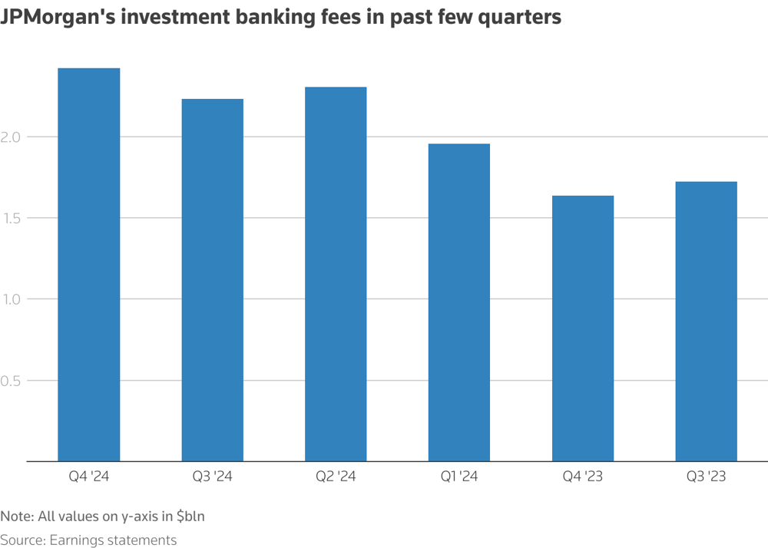
Fundamentals
📈 Earnings Momentum
Q4 2024 Net Income: $14.0B (+50% YoY)
Full-Year 2024 Net Income: Record $58.5B (+18% YoY)
EPS: $4.81 (above expectations)
Revenue (Q4 2024): $43.7B (+10% YoY)
Strong Net Interest Income (NII) despite Q4 slight dip (-3% YoY); 2025 guidance positive at ~$94B.
🏦 Investment Banking & Trading
Investment Banking Fees (Q4 2024): Surged +49% YoY; multi-year highs.
Trading Revenue: +21% YoY, driven by fixed-income and equity derivatives.
Payments Revenue: Hit record ~$18B in 2024, highlighting diversified income.
💼 Financial Health & Ratios
CET1 Capital Ratio: Robust ~14–15% (above regulatory requirements).
Liquidity: $1.4T cash/marketable securities, $547B loss-absorbing capacity.
Asset Quality: Low net charge-offs ($2.4B on $1.3T+ loan book, mainly cards).
Profitability Metrics: Return on Equity ~17%, Return on Tangible Equity ~21%
Efficiency Ratio: Low-50%, strong cost discipline (expenses down 7% YoY).
📊 Valuation Metrics
P/E Ratio: ~12–13x (slightly above historical average ~11x).
Price-to-Book Ratio: ~2.0x (premium reflecting superior returns/stability).
Dividend Yield: ~2%; steadily rising (current dividend $1.05/share).
Share Buybacks: Restarted in 2H 2023 after regulatory pause.
Stock Performance: +41% total return in 2024, outperforming market.
🎯 Investment Rationale
Strong financial momentum with diversified growth drivers.
Attractive valuation post recent volatility presents a favorable entry point.
Solid fundamentals position JPM well for continued outperformance.

Slide 7
Risk
📉 Regulatory Risks
Uncertainty around capital requirements; potential tighter regulations.
Regulatory scrutiny as a major U.S. systemic bank could impact flexibility.
🌎 Macroeconomic Risks
Potential economic slowdown increasing loan defaults.
Exposure to consumer and corporate credit quality deterioration in downturn.
📊 Interest Rate & Inflation Risks
Persistent inflation could lead Fed to maintain higher rates, pressuring margins.
Interest rate volatility impacts net interest income stability and trading revenues.
🌐 Political & Trade Risks
Return of Trump-era tariffs may raise costs, dampen business investment/spending.
Escalation in trade conflicts could negatively affect credit demand and corporate profitability.
💻 Competitive & Technological Risks
Growing fintech competition in payments and consumer lending.
Cybersecurity threats could harm reputation and operations.
🛡️ Mitigation Factors
Strong capital and liquidity buffers provide resilience.
Diversified revenue streams reduce impact of single-sector risks.

Slide 8
Proposal and Exit strategy
💡 Investment Proposal
Action: Buy (Short-term, 3-month holding)
Allocation: ~10% of portfolio
Entry Price: ~$240 (current levels)
Price Target: ~$270 (12% upside potential)
Stop-Loss: Set around ~$215–$220 (-10% downside protection)
📅 Catalysts to Watch (Next 3 Months)
📊 Earnings Catalyst
Q1 2025 Earnings (April 11): Anticipating strong performance driven by solid consumer spending and fee income.
🏛️ Regulatory Developments
Possible easing of capital rules and regulatory requirements under current administration.
🏦 Federal Reserve Policy
Potential signals of interest rate cuts or a dovish policy stance boosting sentiment in financial stocks.
📢 Trade Policy Clarification
Reduction or clarification of tariffs by the administration, improving market confidence and economic outlook.
🛑 Exit Strategy
Target Price Achievement (~$270): Exit upon reaching target.
Time Horizon: Reassess at 3-month mark (end of Q2 2025).
Negative Catalysts: Exit early if significant deterioration in earnings, macroeconomic conditions, or regulatory environment occurs.

Slide 9
Thank you.

